Slide 1
THE ROTARY FOUNDATION
DOING GOOD IN THE WORLD
1917-2019
Notes:
Thank you for having me here today to speak with you about The Rotary Foundation and, in particular, about our Annual Fund.
I’d like to start our session by getting to know a little bit more about you and your interest in Rotary.
Through a show of hands, how many of you joined Rotary to participate in service and make a difference?
Rotary truly is a premier international service organization. As Rotarians, we see solutions to challenges in our communities, and we take action to bring those ideas to life. One of the benefits of being a Rotarian is access to funding from The Rotary Foundation to create meaningful grants both here in your community and elsewhere in the world.
It is a Foundation for Rotarians — it funds grants that are created by Rotarians, and it is supported solely by voluntary contributions from Rotarians, like you, and friends of our Foundation who share its vision of a better world.

Slide 2
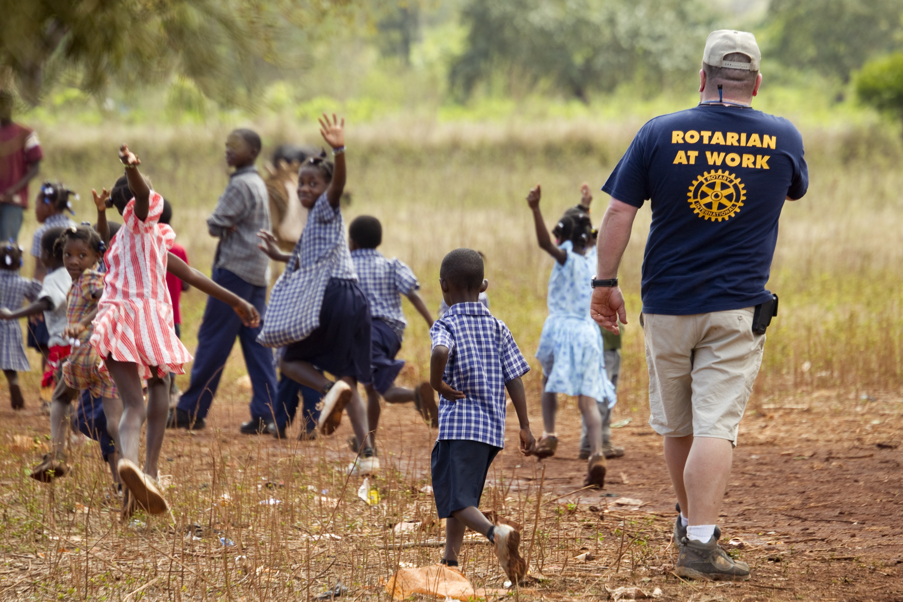
The Rotary Foundation is a not-for-profit corporation supported solely by voluntary contributions from Rotarians and friends of the Foundation who share its goal to foster goodwill, understanding and peace throughout the world.

Slide 3
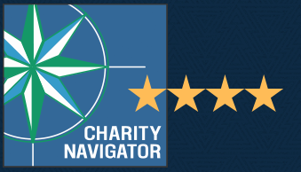
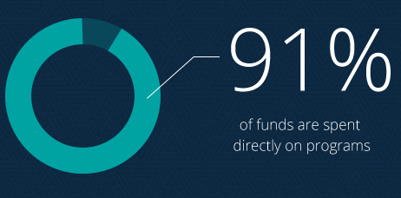

OUTSTANDING PERFORMANCE
Top rating from Charity Navigator
World’s Outstanding Foundation
Top 10 charity changing the world
Careful oversight by Rotarians
Notes:
The generosity of our members and the good work that we do have not gone unrecognized. Our Foundation is carefully overseen by your fellow Rotarians on the Board of Trustees. They ensure that your donations are invested well and spent wisely to do good in the world.
In 2016, we received top ratings from Charity Navigator, the leading evaluator for nonprofits in the U.S., in recognition of our exceptional impact, accountability, and transparency.
The Association of Fundraising Professionals named us the World’s Outstanding Foundation, and CNBC named us one of the top 10 charities changing the world for the second consecutive year.
Plus, in 2016-17, the Foundation celebrated its centennial year — a milestone that few other organizations reach.

Slide 4

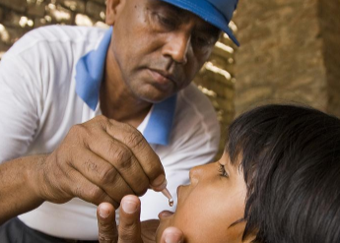

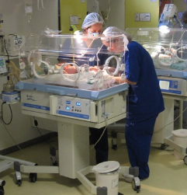

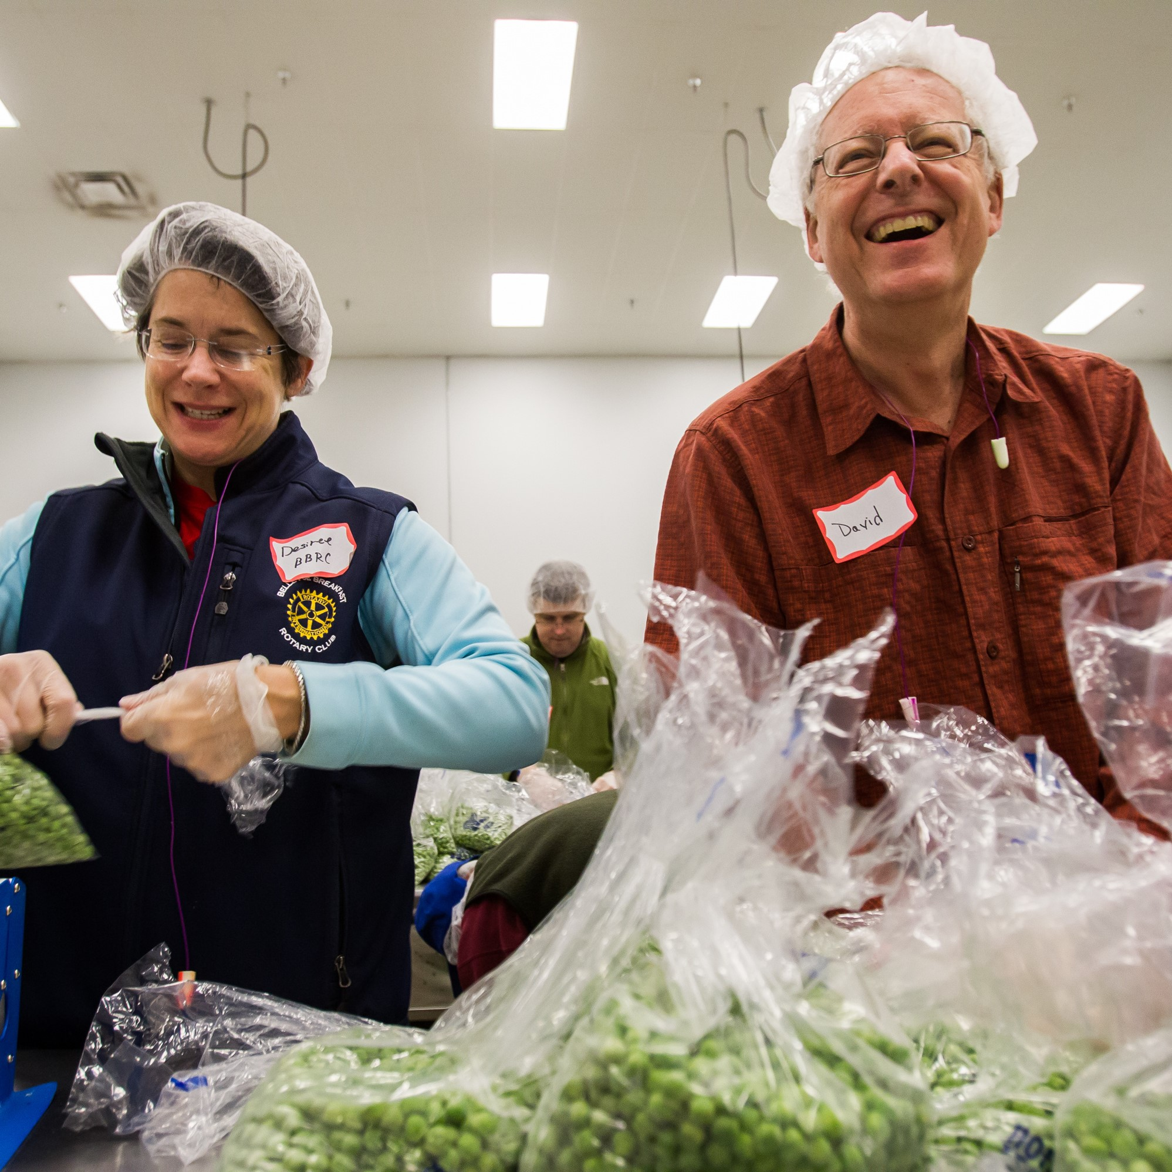
OUR CAUSES // AREA OF FOCUS
Promoting peace
Fighting disease
Providing clean water
Saving mothers and children
Supporting education
Growing local economies
Prevent and mediate conflict
Polio, HIV/AIDS, Malaria
Sanitation and hygiene
6 million children under 5 years of age die of malnutrition
775 million under 15 years of age are illiterate
Enhance projects in impoverished communities
Notes:
Our Foundation is dedicated to six causes — or areas of focus — that build international relationships, improve lives, and promote a more peaceful world.
Looking at these images, do you see something that resonates with you? What are you passionate about?
The Rotary Foundation can help you turn the passion you have for a specific cause into a reality. Rotarians are encouraged to spearhead efforts in these six areas, and The Rotary Foundation is here to make those grants possible.
In fact, the very mission of our Foundation is to enable Rotarians to advance world understanding, goodwill, and peace through the improvement of health, the support of education, and the alleviation of poverty.

Slide 5



AN ILLUSTRATION OF ROTARY FOUNDATION FUNDING
THE
ROTARY
FOUNDATION
(TRF)
PROGRAM
FUNDING
ROTARIAN
CONTRI-BUTIONS
DISTRICT
DESIGNATED
FUND (DDF)
SHARE
WORLD
FUND
INVESTMENT
EARNINGS
Notes:
The generosity of our members and the good work that we do have not gone unrecognized. Our Foundation is carefully overseen by your fellow Rotarians on the Board of Trustees. They ensure that your donations are invested well and spent wisely to do good in the world.
In 2016, we received top ratings from Charity Navigator, the leading evaluator for nonprofits in the U.S., in recognition of our exceptional impact, accountability, and transparency.
The Association of Fundraising Professionals named us the World’s Outstanding Foundation, and CNBC named us one of the top 10 charities changing the world for the second consecutive year.
Plus, in 2016-17, the Foundation celebrated its centennial year — a milestone that few other organizations reach.

Slide 6


THREE FUNDS RECEIVING DONATIONS
Notes:
The generosity of our members and the good work that we do have not gone unrecognized. Our Foundation is carefully overseen by your fellow Rotarians on the Board of Trustees. They ensure that your donations are invested well and spent wisely to do good in the world.
In 2016, we received top ratings from Charity Navigator, the leading evaluator for nonprofits in the U.S., in recognition of our exceptional impact, accountability, and transparency.
The Association of Fundraising Professionals named us the World’s Outstanding Foundation, and CNBC named us one of the top 10 charities changing the world for the second consecutive year.
Plus, in 2016-17, the Foundation celebrated its centennial year — a milestone that few other organizations reach.

Slide 7
FUND #1
Rotarian and
Non-Rotarian Donations
Used exclusively for
Polio Eradication
Funds do not move through
District Designated Fund (DDF)
or World Fund
Notes:
The generosity of our members and the good work that we do have not gone unrecognized. Our Foundation is carefully overseen by your fellow Rotarians on the Board of Trustees. They ensure that your donations are invested well and spent wisely to do good in the world.
In 2016, we received top ratings from Charity Navigator, the leading evaluator for nonprofits in the U.S., in recognition of our exceptional impact, accountability, and transparency.
The Association of Fundraising Professionals named us the World’s Outstanding Foundation, and CNBC named us one of the top 10 charities changing the world for the second consecutive year.
Plus, in 2016-17, the Foundation celebrated its centennial year — a milestone that few other organizations reach.

Slide 8

FUND #2
Primary source of support
for the programs of
The Rotary Foundation
Ambassadorial Scholarships
District Designated Funds (DDF)
Matching Grants
Notes:
The generosity of our members and the good work that we do have not gone unrecognized. Our Foundation is carefully overseen by your fellow Rotarians on the Board of Trustees. They ensure that your donations are invested well and spent wisely to do good in the world.
In 2016, we received top ratings from Charity Navigator, the leading evaluator for nonprofits in the U.S., in recognition of our exceptional impact, accountability, and transparency.
The Association of Fundraising Professionals named us the World’s Outstanding Foundation, and CNBC named us one of the top 10 charities changing the world for the second consecutive year.
Plus, in 2016-17, the Foundation celebrated its centennial year — a milestone that few other organizations reach.

Slide 9
FUND #3
Rotary’s endowment fund
Principal never spent
Portion of earnings support programs
Notes:
The generosity of our members and the good work that we do have not gone unrecognized. Our Foundation is carefully overseen by your fellow Rotarians on the Board of Trustees. They ensure that your donations are invested well and spent wisely to do good in the world.
In 2016, we received top ratings from Charity Navigator, the leading evaluator for nonprofits in the U.S., in recognition of our exceptional impact, accountability, and transparency.
The Association of Fundraising Professionals named us the World’s Outstanding Foundation, and CNBC named us one of the top 10 charities changing the world for the second consecutive year.
Plus, in 2016-17, the Foundation celebrated its centennial year — a milestone that few other organizations reach.

Slide 10
SHARE
The SHARE system transforms donations to the Annual Fund and investment earnings from the Permanent Fund into
District Designated Funds,
Matching Grants,
Ambassadorial Scholarships,
and other programs worldwide
Each year*, contributions to Annual Programs Fund divided into two funds:
50% credited to District Designated Fund
50% credited to World Fund
DISTRICT
DESIGNATED
FUND (DDF)
SHARE
WORLD
FUND
*(TRF cycle uses contributions for programs 3-years after they are received)
Notes:
The generosity of our members and the good work that we do have not gone unrecognized. Our Foundation is carefully overseen by your fellow Rotarians on the Board of Trustees. They ensure that your donations are invested well and spent wisely to do good in the world.
In 2016, we received top ratings from Charity Navigator, the leading evaluator for nonprofits in the U.S., in recognition of our exceptional impact, accountability, and transparency.
The Association of Fundraising Professionals named us the World’s Outstanding Foundation, and CNBC named us one of the top 10 charities changing the world for the second consecutive year.
Plus, in 2016-17, the Foundation celebrated its centennial year — a milestone that few other organizations reach.

Slide 11
AN ILLUSTRATION OF ROTARY FOUNDATION FUNDING
THE
ROTARY
FOUNDATION
(TRF)
PROGRAM
FUNDING
ROTARIAN
CONTRI-BUTIONS
DISTRICT
DESIGNATED
FUND (DDF)
SHARE
WORLD
FUND
INVESTMENT
EARNINGS
Notes:
The generosity of our members and the good work that we do have not gone unrecognized. Our Foundation is carefully overseen by your fellow Rotarians on the Board of Trustees. They ensure that your donations are invested well and spent wisely to do good in the world.
In 2016, we received top ratings from Charity Navigator, the leading evaluator for nonprofits in the U.S., in recognition of our exceptional impact, accountability, and transparency.
The Association of Fundraising Professionals named us the World’s Outstanding Foundation, and CNBC named us one of the top 10 charities changing the world for the second consecutive year.
Plus, in 2016-17, the Foundation celebrated its centennial year — a milestone that few other organizations reach.

Slide 12
DDF & WORLD FUND
Each year individual Districts decide how to use the funds returned from TRF. Funds received each year represent 50% of District contributions 3-years earlier. Allows for accurate planning for future program activities.
DISTRICT
DESIGNATED
FUND (DDF)
WORLD
FUND
World Fund pays for worldwide programs available to all Rotary Districts, such as Matching Grants.
Notes:
The generosity of our members and the good work that we do have not gone unrecognized. Our Foundation is carefully overseen by your fellow Rotarians on the Board of Trustees. They ensure that your donations are invested well and spent wisely to do good in the world.
In 2016, we received top ratings from Charity Navigator, the leading evaluator for nonprofits in the U.S., in recognition of our exceptional impact, accountability, and transparency.
The Association of Fundraising Professionals named us the World’s Outstanding Foundation, and CNBC named us one of the top 10 charities changing the world for the second consecutive year.
Plus, in 2016-17, the Foundation celebrated its centennial year — a milestone that few other organizations reach.

Slide 13
MATCHING MAGIC
“Matching Magic”
How $1.00 becomes $3.50 through the “Magic” of the Matching Grant
Next year RCDI could donate $4,000 of our Duck Race proceeds to the District 7770 Water Projects fund. When applied to a specific project funded through a TRF Matching Grant, our $4,000 would grow to $14,000 in economic benefit!
Rotary Club donates $4,000 towards a Matching Grant
District matches dollar-for-dollar
TRF matches District donation dollar-for-dollar
TRF matches Club donation $0.50-per-dollar
$4,000
$4,000
$4,000
$2,000
Total: $14,000
Notes:
The generosity of our members and the good work that we do have not gone unrecognized. Our Foundation is carefully overseen by your fellow Rotarians on the Board of Trustees. They ensure that your donations are invested well and spent wisely to do good in the world.
In 2016, we received top ratings from Charity Navigator, the leading evaluator for nonprofits in the U.S., in recognition of our exceptional impact, accountability, and transparency.
The Association of Fundraising Professionals named us the World’s Outstanding Foundation, and CNBC named us one of the top 10 charities changing the world for the second consecutive year.
Plus, in 2016-17, the Foundation celebrated its centennial year — a milestone that few other organizations reach.

Slide 14
A ROTARY FOUNDATION GLOSSARY
Benefactor – You may become a Benefactor by making the Permanent Fund a beneficiary in your estate plans or by donating $1,000 or more to the Fund outright.
A number of members of RCDI are Rotary Benefactors!
Bequest Society – Couples or individuals who have made commitments of $10,000 or more in their estate plans, such as in a will, living trust, or through whole or universal life insurance, can become Bequest Society members.
A number of members of RCDI are Bequest Society Members!
EREY: “Every Rotarian Every Year” – Club donates per-capita minimum $100 per member to the Annual Programs Fund AND every club member contributes some amount to the Fund each year. The RCDI is an EREY club!
Major Donor - couples or individuals whose combined personal outright or cumulative giving has reached $10,000.
A number of members of RCDI are Major Donors!
Notes:
The generosity of our members and the good work that we do have not gone unrecognized. Our Foundation is carefully overseen by your fellow Rotarians on the Board of Trustees. They ensure that your donations are invested well and spent wisely to do good in the world.
In 2016, we received top ratings from Charity Navigator, the leading evaluator for nonprofits in the U.S., in recognition of our exceptional impact, accountability, and transparency.
The Association of Fundraising Professionals named us the World’s Outstanding Foundation, and CNBC named us one of the top 10 charities changing the world for the second consecutive year.
Plus, in 2016-17, the Foundation celebrated its centennial year — a milestone that few other organizations reach.

Slide 15
A ROTARY FOUNDATION GLOSSARY, continued
Paul Harris Fellow (PHF) – Donors of aggregate $1,000 or more to the Annual Programs Fund, PolioPlus, or the Humanitarian Grants Program, OR individuals who have that amount contributed in their name.
RCDI is a 100% PHF club even though newer members who are not at the PHF level yet.
Paul Harris Society – Donors agree to contribute $1,000 or more per year to the Annual Programs Fund, PolioPlus, or the Humanitarian Grants Program.
RCDI has enrolled six members in the Paul Harris Society over the years.
Sustaining Member – Member personally contributes $100 or more to the Annual Programs Fund during the Rotary year.
RCDI is a 100% Sustaining Member club.
Notes:
The generosity of our members and the good work that we do have not gone unrecognized. Our Foundation is carefully overseen by your fellow Rotarians on the Board of Trustees. They ensure that your donations are invested well and spent wisely to do good in the world.
In 2016, we received top ratings from Charity Navigator, the leading evaluator for nonprofits in the U.S., in recognition of our exceptional impact, accountability, and transparency.
The Association of Fundraising Professionals named us the World’s Outstanding Foundation, and CNBC named us one of the top 10 charities changing the world for the second consecutive year.
Plus, in 2016-17, the Foundation celebrated its centennial year — a milestone that few other organizations reach.

Slide 16
OUR CLUB’S FOUNDATION GOALS FOR THE 2019 – 2020 FISCAL YEAR
PolioPlus: $2,190 – Ace of Spades contribution + “Fines” in support of goal
Annual Programs Fund: $24,820 – Challenge Goal of $31,025 – Members’ $100 per year + Paul Harris Society members @ $1,000 each + contribution from Rotary Club of Daniel Island Foundation
Continue to be an EREY Club – Club averages $100 per member and each member donates something to the Annual Programs Fund
Continue as a “100% Sustaining Member” Club – Each member contributes at least $100 to the Annual Programs Fund during the Rotary Year
Recognize Non-Rotarian community supporters with Paul Harris Fellow awards
Our Club exceeded both our Polio Plus and Annual Fund Goals last year!!
Notes:
The generosity of our members and the good work that we do have not gone unrecognized. Our Foundation is carefully overseen by your fellow Rotarians on the Board of Trustees. They ensure that your donations are invested well and spent wisely to do good in the world.
In 2016, we received top ratings from Charity Navigator, the leading evaluator for nonprofits in the U.S., in recognition of our exceptional impact, accountability, and transparency.
The Association of Fundraising Professionals named us the World’s Outstanding Foundation, and CNBC named us one of the top 10 charities changing the world for the second consecutive year.
Plus, in 2016-17, the Foundation celebrated its centennial year — a milestone that few other organizations reach.

Slide 17
“WHAT CAN I DO?”
1. Your quarterly Club dues include $25 toward your $100 annual contribution to the Annual Programs Fund and your continuing Sustaining Member designation. Thank You!
2. Consider becoming a Benefactor by making the Rotary Foundation a beneficiary in your estate plans.
3. Consider becoming a Paul Harris Society member by arranging for a recurring annual contribution of $1,000/$84 per month to the Annual Programs Fund or PolioPlus.
4. Advance becoming a Fellow by making a contribution to the Annual Programs Fund over and above your $25 per quarter. Until Dec 20, you can advantage of matches from the Club and/or the District.
Notes:
The generosity of our members and the good work that we do have not gone unrecognized. Our Foundation is carefully overseen by your fellow Rotarians on the Board of Trustees. They ensure that your donations are invested well and spent wisely to do good in the world.
In 2016, we received top ratings from Charity Navigator, the leading evaluator for nonprofits in the U.S., in recognition of our exceptional impact, accountability, and transparency.
The Association of Fundraising Professionals named us the World’s Outstanding Foundation, and CNBC named us one of the top 10 charities changing the world for the second consecutive year.
Plus, in 2016-17, the Foundation celebrated its centennial year — a milestone that few other organizations reach.

Slide 18
“WHAT CAN I DO? – TAKING ADVANTAGE OF MATCHING FUNDS!
1. The Club, through December 20, will match any contribution if it gets you to the Paul Harris Fellow level of $1,000 or to any next level of Paul Harris Fellow. Example 1: you’ve contributed $600 over the years; if you make a contribution of $200, the Club will contribute $200 and you’re a Paul Harris Fellow. Example 2: You’re a Paul Harris Fellow and have contributed $1,200 over the years; if you make a contribution of $400, the Club will contribute $400 and you’re now a Paul Harris +1 Fellow!
2. There is also a District match of 1 recognition point for any dollar you contribute, from $100 through $500.
3. The Club match can get you to the next level; the District match can get you started to the level beyond that!
Notes:
The generosity of our members and the good work that we do have not gone unrecognized. Our Foundation is carefully overseen by your fellow Rotarians on the Board of Trustees. They ensure that your donations are invested well and spent wisely to do good in the world.
In 2016, we received top ratings from Charity Navigator, the leading evaluator for nonprofits in the U.S., in recognition of our exceptional impact, accountability, and transparency.
The Association of Fundraising Professionals named us the World’s Outstanding Foundation, and CNBC named us one of the top 10 charities changing the world for the second consecutive year.
Plus, in 2016-17, the Foundation celebrated its centennial year — a milestone that few other organizations reach.

Slide 19

PAUL HARRIS SOCIETY
Recognizes consistent support of the Foundation
PHS members give 16% of Annual Fund donations
Gifts of $1,000 or more make up 44% of all Annual Fund contributions
Notes:
Some members want to support the Foundation in a significant way each and every year as members of the Paul Harris Society.
[Thank any Paul Harris Society members in the audience.]
The Paul Harris Society recognizes those generous individuals who intend to give $1,000 each year to the Annual Fund, the PolioPlus Fund, or an approved Foundation grant.
Their consistent support is incredibly important to the district. It means that each year, the district can rely on gifts from these donors to fund important district and global grants.
Paul Harris Society members represent about 16 percent of all Annual Fund donations. What more, donors who give $1,000 or more to the fund represent 44 percent of all giving to the Annual Fund. Indeed, Paul Harris Society members are a small but vibrant and growing community of donors who provide vital support for the Foundation and its projects.

Slide 20
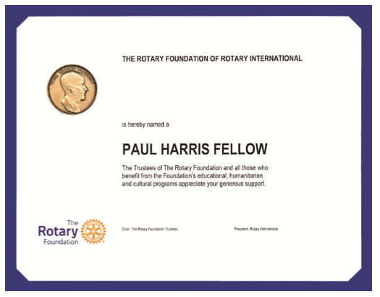
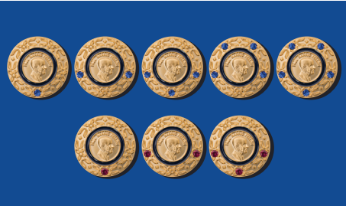
PAUL HARRIS FELLOW
Notes:
We also recognize our generous donors who give to the Foundation as Paul Harris Fellows. Paul Harris Fellows are those whose Annual Fund and PolioPlus Fund contributions — or Foundation recognition points received — total $1,000 or more.
[Thank any Paul Harris Fellows in the audience.]

Slide 21

EASY GIVING THROUGH ROTARY DIRECT
Efficient, secure, and easy
Monthly, quarterly, or annual recurring gifts
Notes:
Is anyone here enrolled in Rotary Direct?
Has anyone considered automating their giving through Rotary Direct?
One of the easiest and most secure ways for us to support our Foundation is through Rotary’s recurring giving program, Rotary Direct. Choose an amount, contribution method, and frequency — monthly, quarterly or annually — that will be convenient for you.
Rotary Direct offers many benefits to donors, top among them is convenience. By automating your giving, you no longer have to remember to write a check each year and you’ll be able to make steady progress toward your philanthropic goals. Plus, the paperwork is far easier to track since you’ll get one annual tax receipt at the close of the tax year, if applicable.
Enrollment is connected with the Foundation’s secure online contribution system and is available in multiple currencies.
[Explain why you chose to give through Rotary Direct, if applicable.]

Slide 22
THANK YOU

